Slide 1
Creating A Law Enforcement Special Training Program Daniel E. Rosenfield, Esq.

Slide 2
A tranquil evening, 20 minutes from
Done For The Week…

Slide 3
Arriving on scene…
Your on private property…
Not your average city scenario

Slide 8
Not a routine call
Containment challenges
Hiding places/dark areas
Large space
Multiple structures

Slide 9
People
Probably so…
Many people may be present
Hostile?
Multiple conflicts presenting?

Slide 14
Large Animals
May not be cooperative

Slide 16
May be excited
Possibly even aggressive

Slide 17
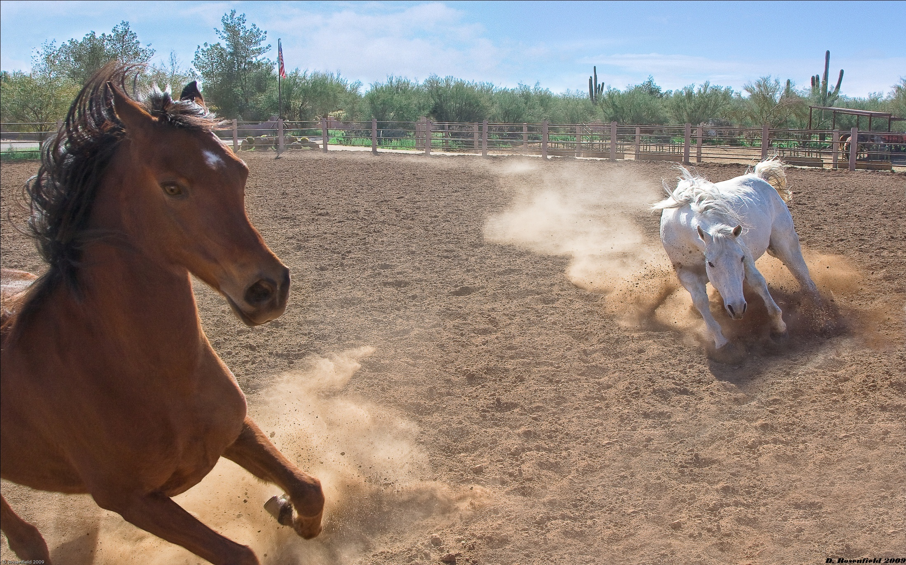

Slide 18
…So Starts The Large Animal Investigation Course…
Program is an Arizona Department of Public Safety training program
All Instructors are POST certified
> 950 officers have been trained

Slide 19
Elements Of A Training Program
1. Fulfilling a need
Offer knowledge and expertise otherwise unavailable
Must be relevant to the audience
Consider entering student’s exposure to subject
2. Program must have credibility
Content
Identifiable benefit – is it useful

Slide 20
Elements Of A Training Program
3. Lesson plan
Must meet LE training standards
Time
Place
Manner
4. Instructors
Must be able to teach
Some should not teach
Must qualify under LE standards

Slide 21
Program Overview
3 elements
1. Situations likely to be encountered
Actual situations encountered
Identify issues presented
Evidence that explains situation
Instructor: Arizona AG Officer
2. Medical conditions likely to be encountered
Discussion of diseases and injuries
Graphic illustrations
Focus on abuse and neglect injuries
Instructor: Licensed Veterinarian

Slide 22
3 elements
3. Law and legal
Analysis of statutes and case law
Evidence collection
Fruit of poisoned tree
Search and seizure
Property rights
3rd party rights
News media
Special interest groups
Law enforcement personnel
Analysis of departmental procedure
Seizure of an animal
When
Who bears the cost
Instructor: Practicing Attorney

Slide 23
Fulfilling Other Needs
Educating officers to help them do their job
Helping officers cope with their job

Slide 24
The End

