Slide 1
Sharing the Trails
Creating and supporting programs that support individuals with special needs
10:00-10:50 am
Lisa Pewe
Envision Therapeutic Horsemanship
www.envisiontherapy.org

Slide 2
Sharing the Trails
Creating and supporting programs that support individuals with special needs
With special guest
Temple Grandin
www.envisiontherapy.org

Slide 3
Welcome
www.envisiontherapy.org

Slide 4
Lisa Pewe
Equine Assisted Life Coach, PATH CTRI and certified Equine Specialist in Mental health and learning. Executive director and Director of Equine Assisted Activities and Therapies (EAAT) at Envision Therapeutic Horsemanship, a 501 c3 Not for profit organization.
www.envisiontherapy.org

Slide 5
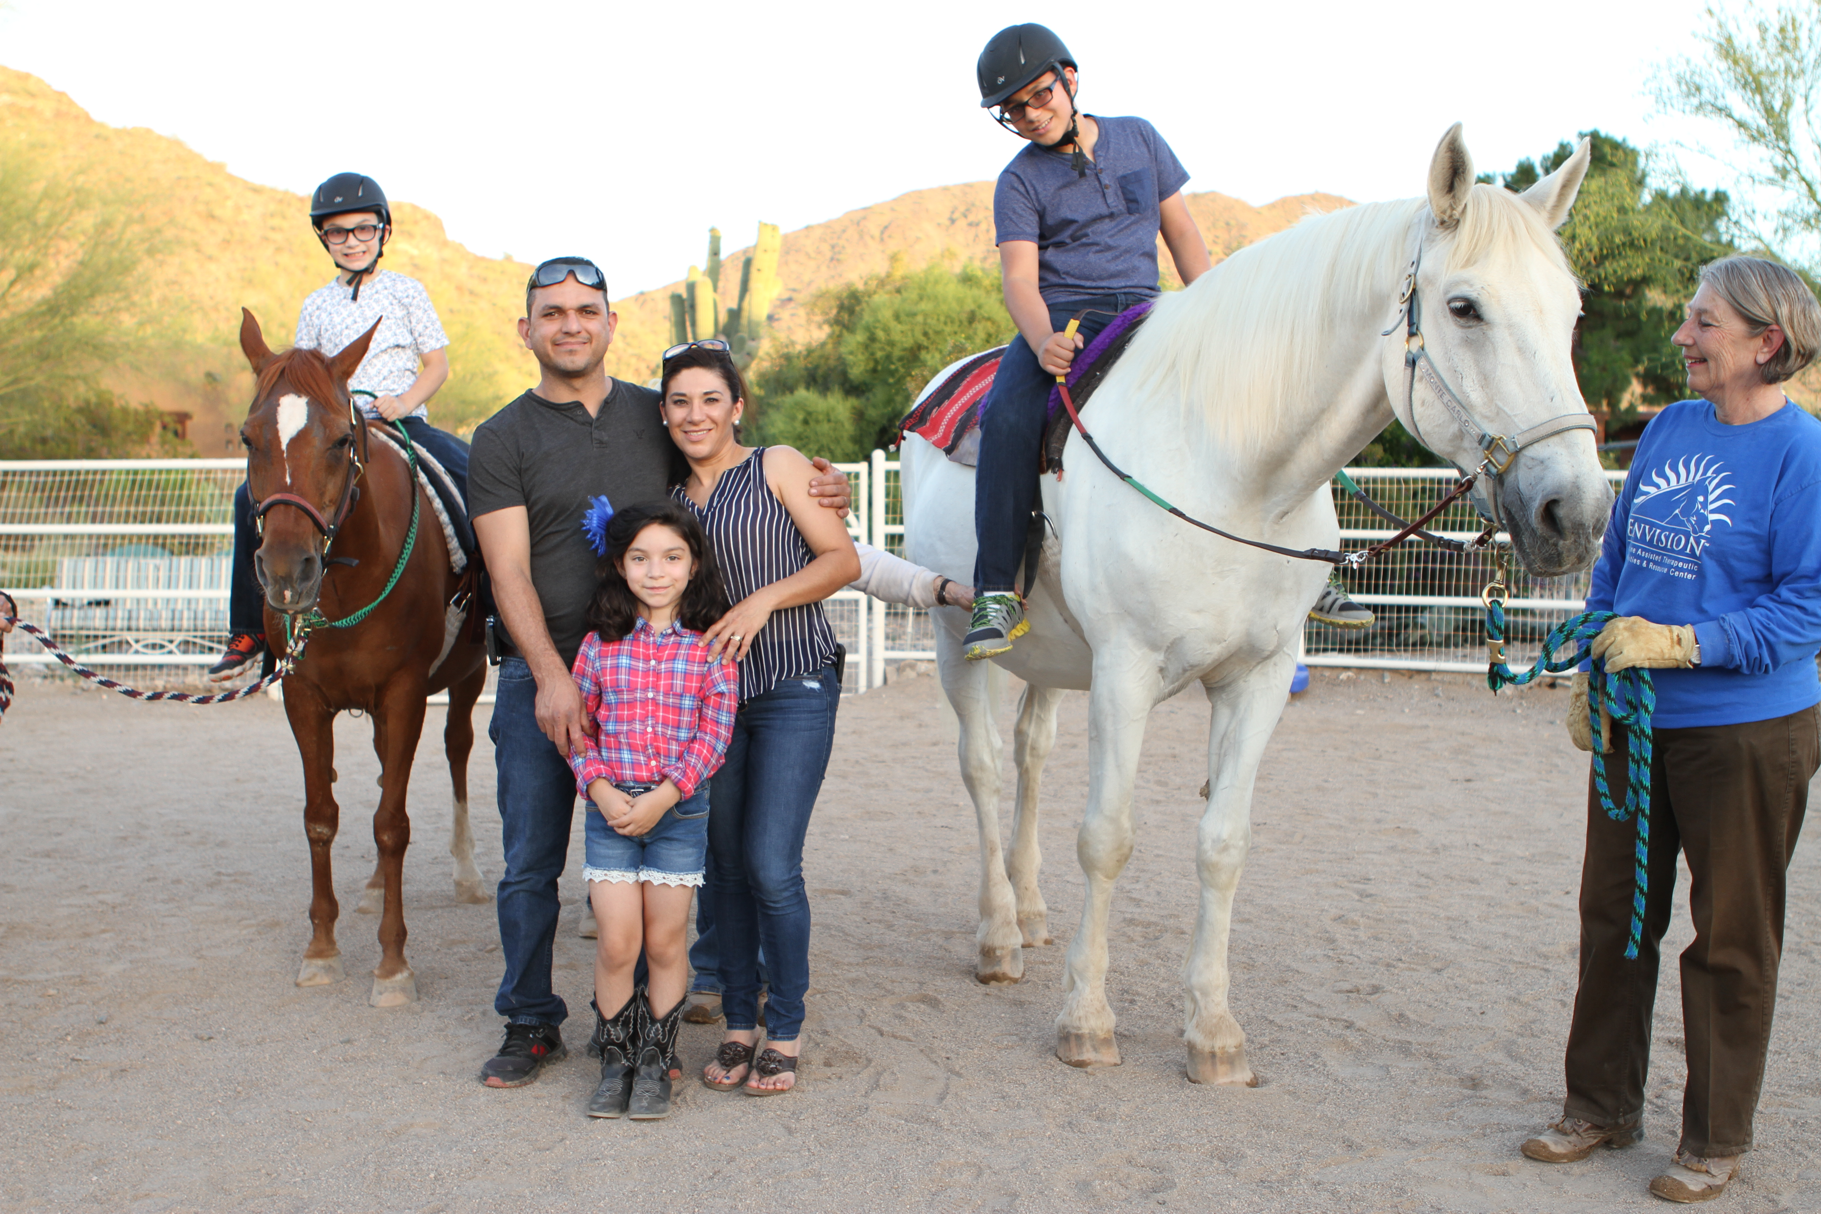
“Our 6-year-old son, Julian, has autism, was non-verbal and very depressed. His older brother, Jesus, has high functioning autism and was being bullied at school. We were very afraid that he would be recruited by gangs. Since coming to Envision, Julian now speaks and asks to ride his favorite horse, Lullaby. Jesus now carries himself with confidence and the bullying has stopped. We are no longer worried about him being vulnerable to gang recruitment.

Slide 6
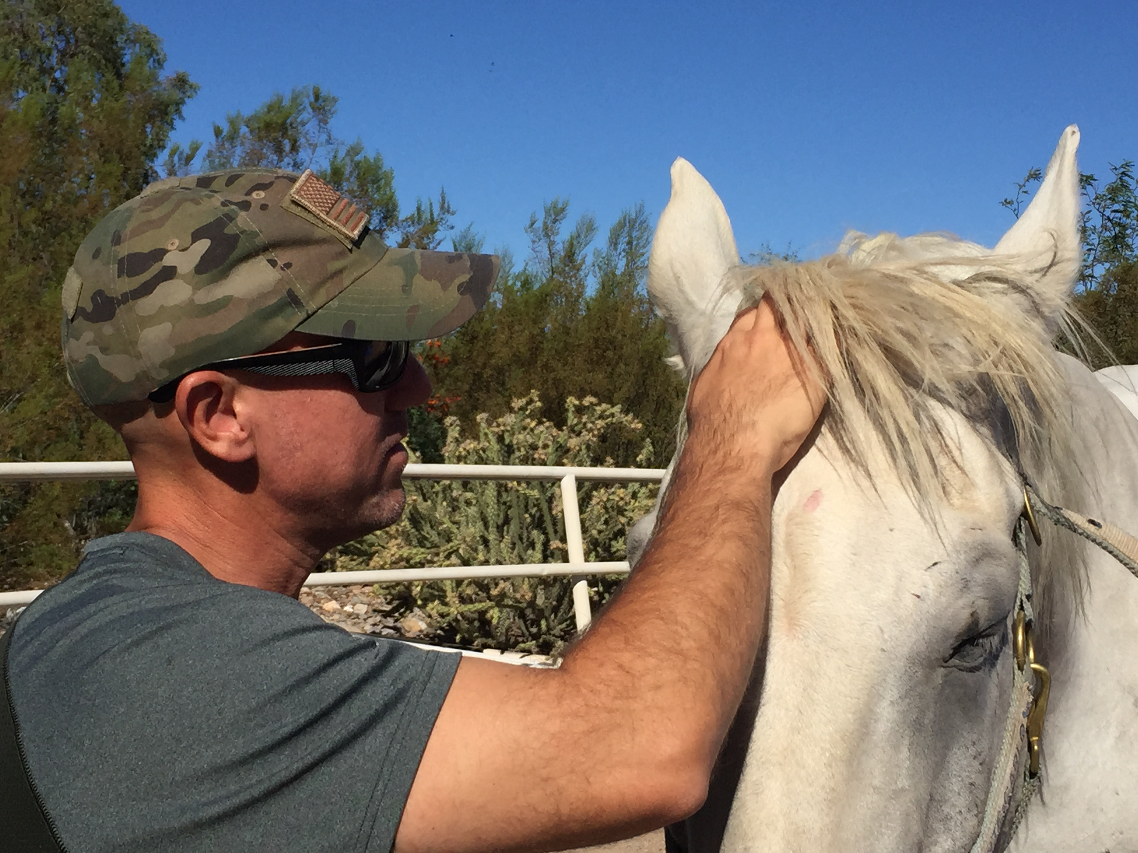
“My husband is a returning veteran; he is a wonderful man but our family is having a difficult time adjusting to his return. He is having a difficult time as well with family and at work. I have heard that working with horses can be helpful for veterans with PTSD and
their families.
Can you help?”

Slide 7
“I was sexually abused by my coach in high school for four years. I thought I was over it but now I am really struggling in my life. It is negatively effecting my work and my relationships. I have a counselor and she suggested that I call Envision. She said that she has referred other clients to Envision and they have been able to help them get through some emotional blocks in their healing.
Can you help?”

Slide 8
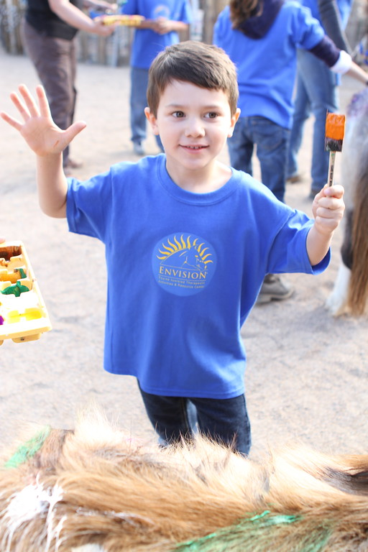
“We frequently recommend Envision to other families – the benefits are huge. It complements OT, PT and speech therapy. It provides an activity that reinforces all the things that our child’s therapists are working on and he likes it! Thanks, Envision, for saying ”YES”.
Mother of a child with autism

Slide 9
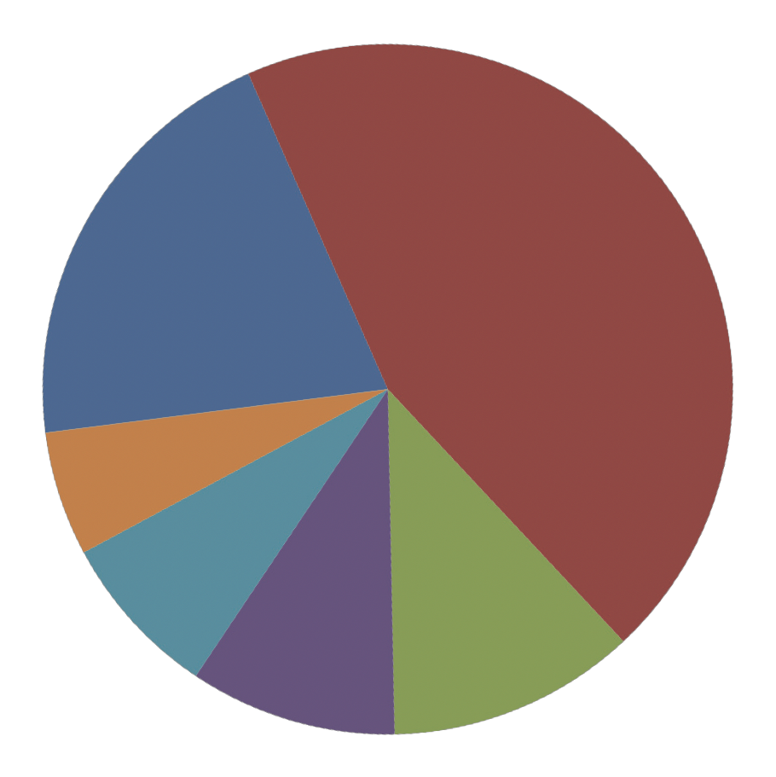
Children and Teens: effected by foster care, poverty, grief, homelessness, ADHD, bullying, and needing to develop social skills and self-esteem.
Victims of Abuse: domestic violence, sex-traf cking, general trauma and often suffering from PTSD
Adults: recovering from addiction, divorce, homelessness and other nega- tive life circumstances
Children and adults: with cognitive and physical disabilities: Autism, Down syndrome, traumatic brain injury, muscular dystrophy, multiple sclerosis, cerebral palsy, stroke and amputees
Military Veterans and families: t struggling with the effects of post de- ployment return including PTSD and family reintegration.
Siblings and Caregivers: we are committed to helping the families of those we serve.
46%
20%
6%
8%
12%
10%

Slide 10
Welcome
www.envisiontherapy.org

Slide 11
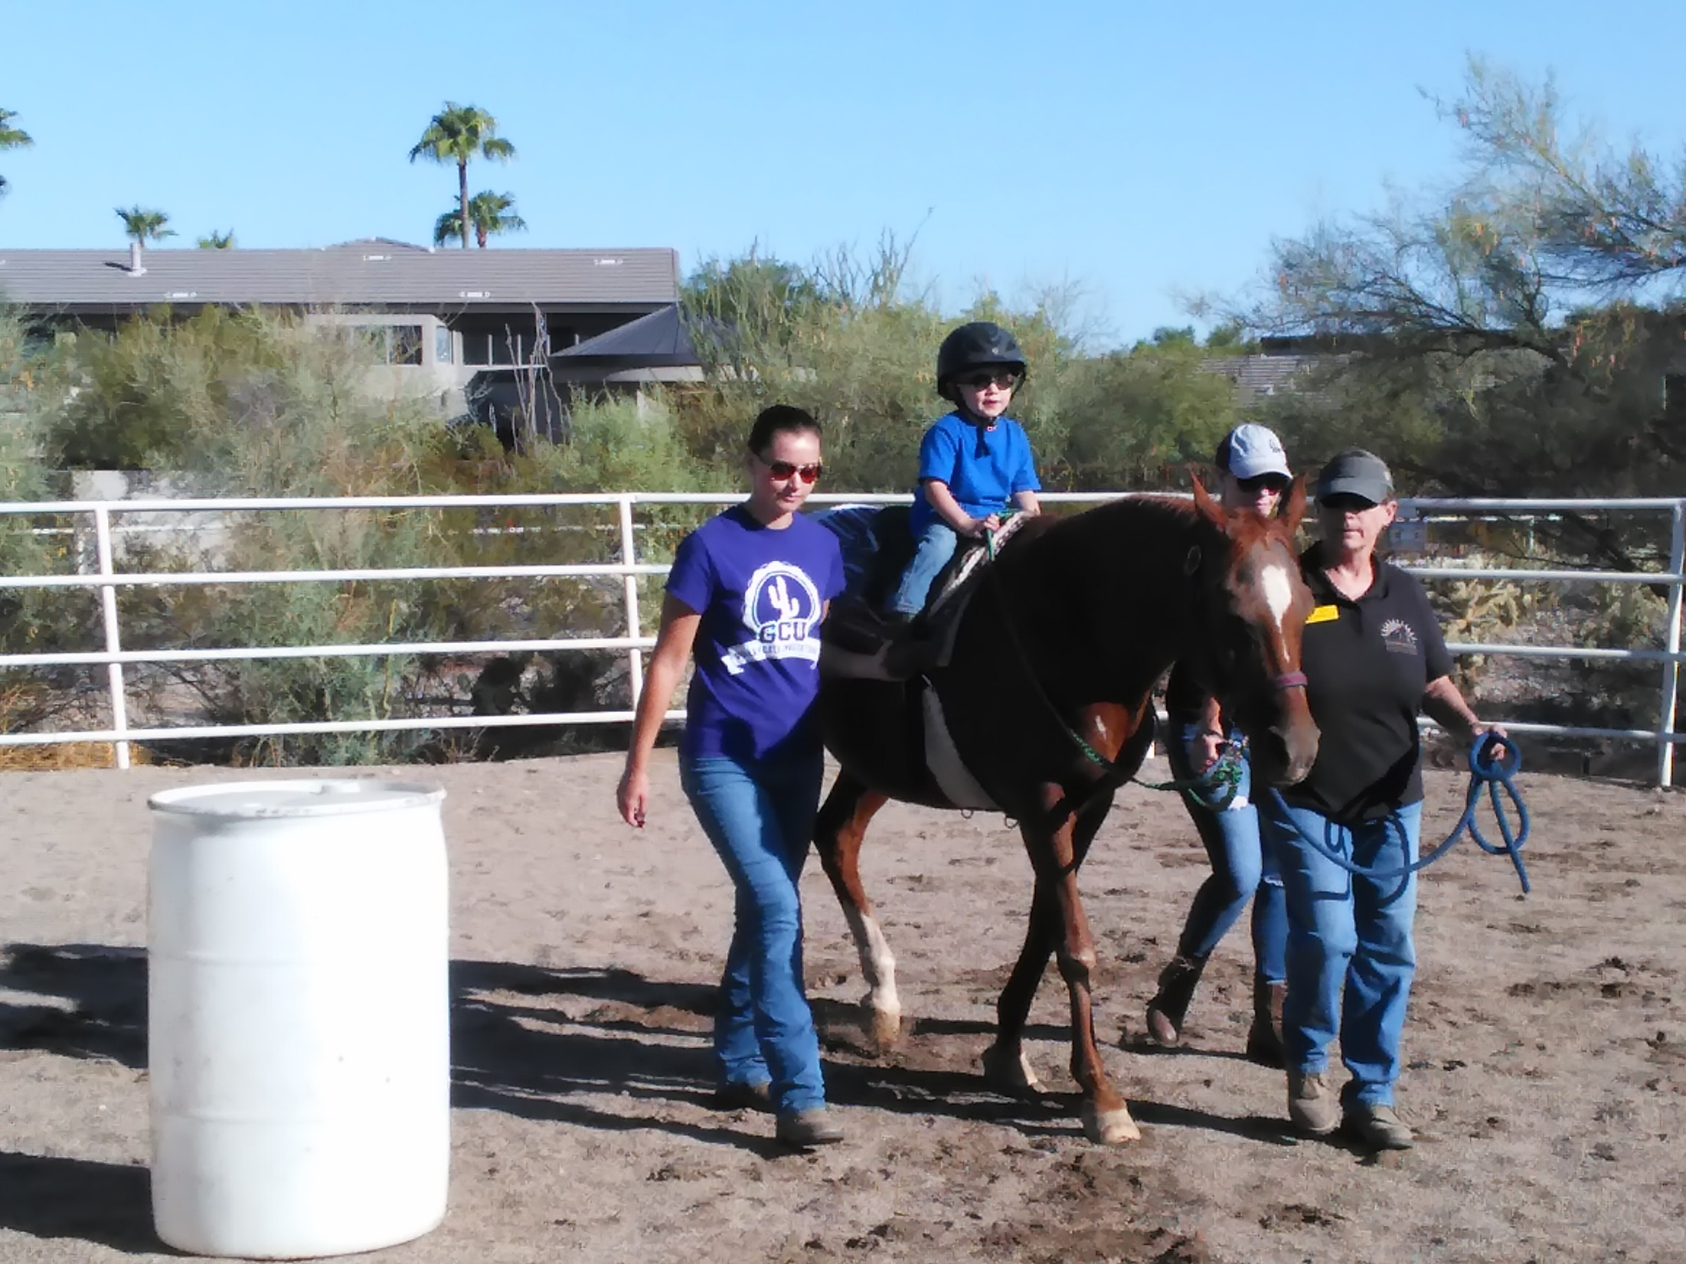
Welcome
www.envisiontherapy.org

Slide 12
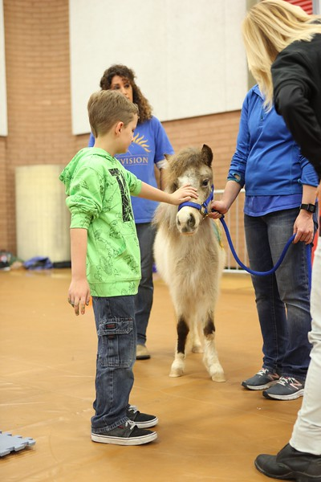
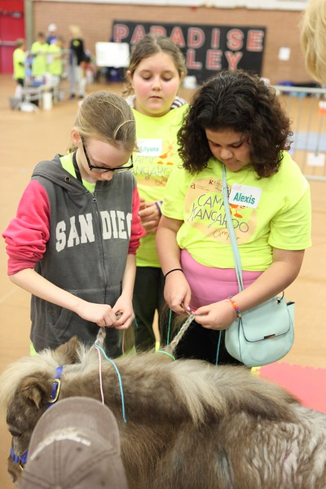
Partnering with Seasons Hospice for Camp Kangaroo

Slide 13
A program of the Bridge Church with equine services provided by Envision
www.envisiontherapy.org

Slide 14
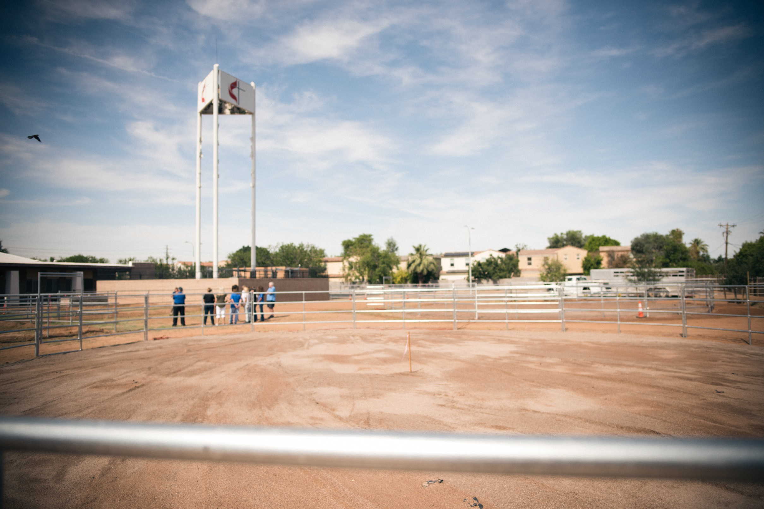
Welcome
www.envisiontherapy.org

Slide 15
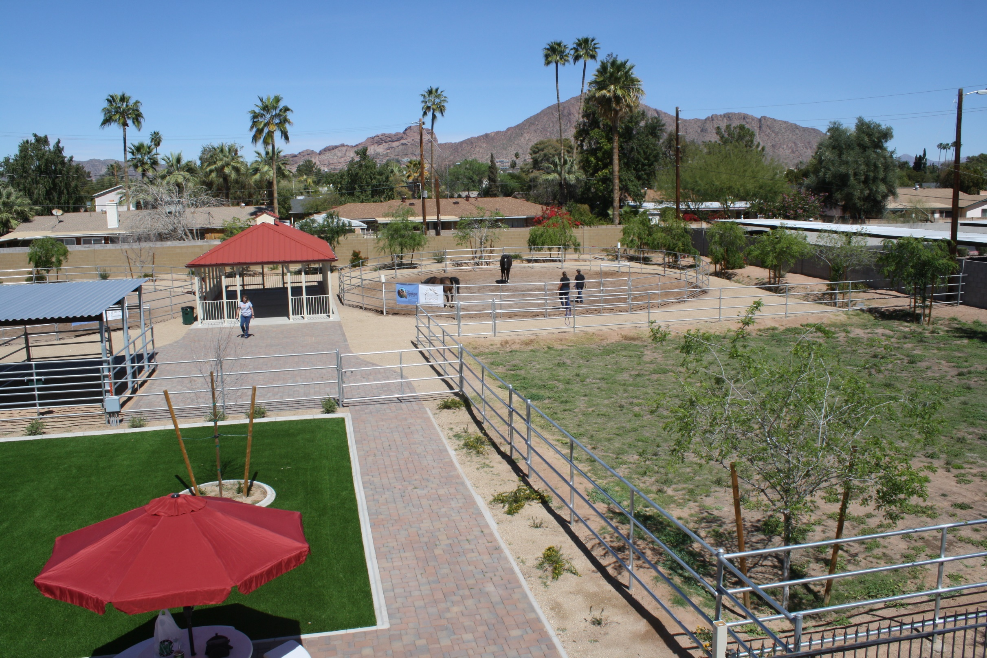
Welcome
www.envisiontherapy.org

Slide 16
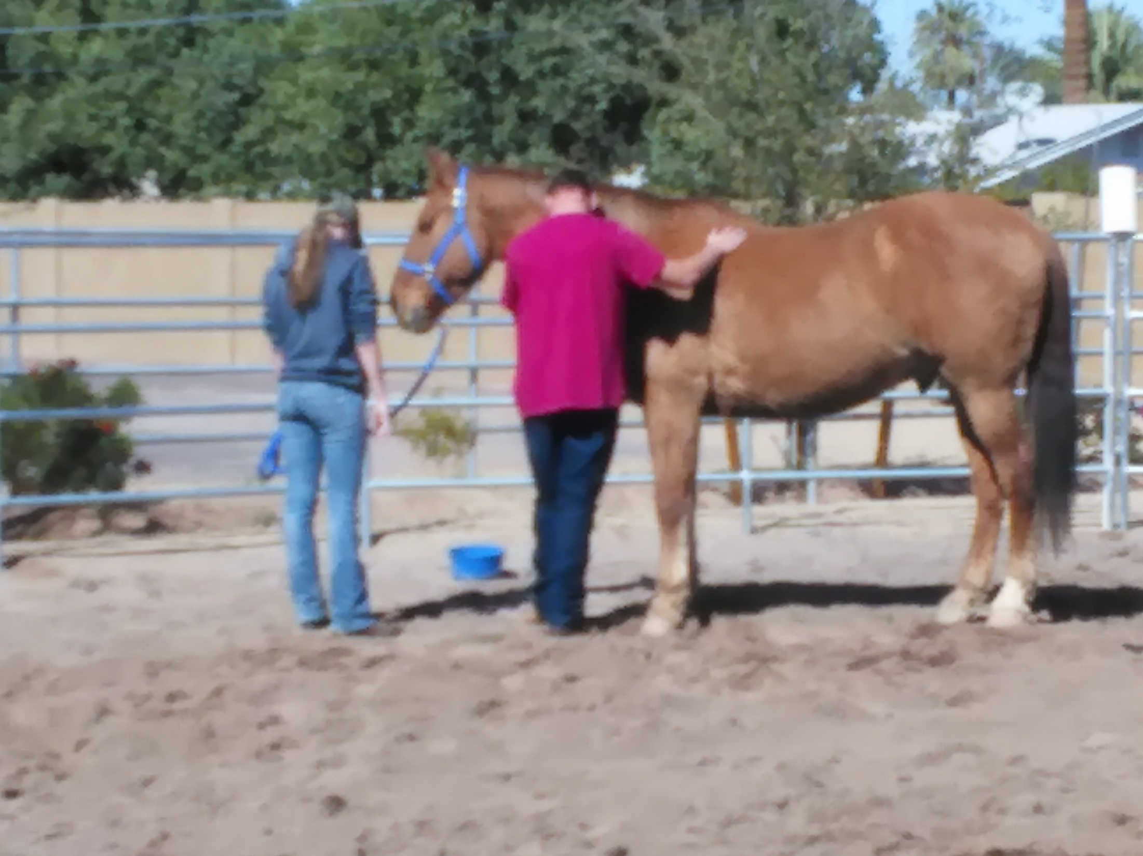
Envision partners with K2 Adventures Foundation and The Healing Post to help Children in the Arizona foster care system
www.envisiontherapy.org

Slide 17
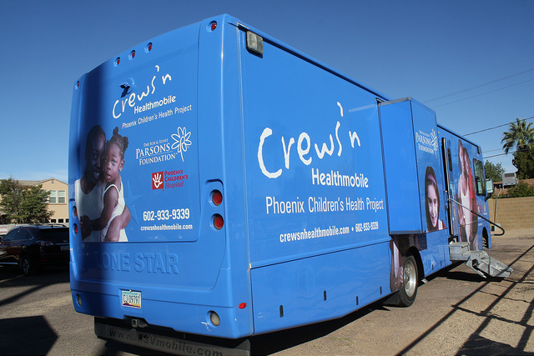
The Young Leaders program with Envision, The Healing Post and in friendship with Phoenix Children's Hospital Homeless Youth Outreach
www.envisiontherapy.org

Slide 18
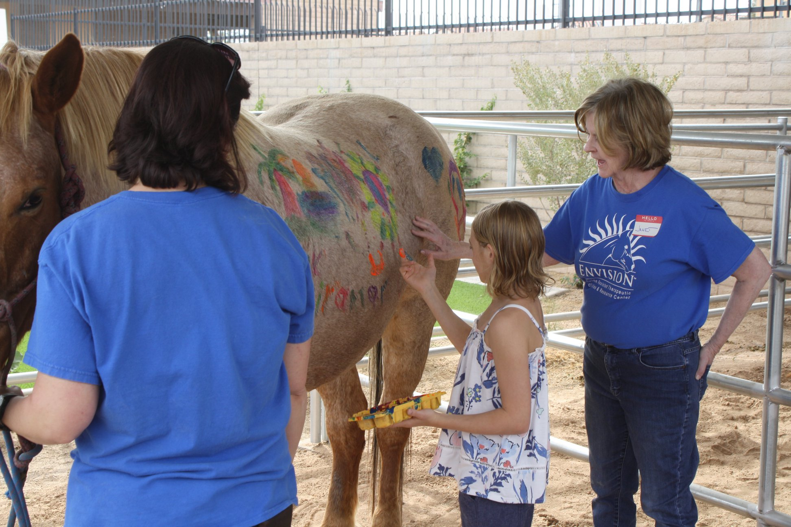
Welcome
www.envisiontherapy.org

Slide 19
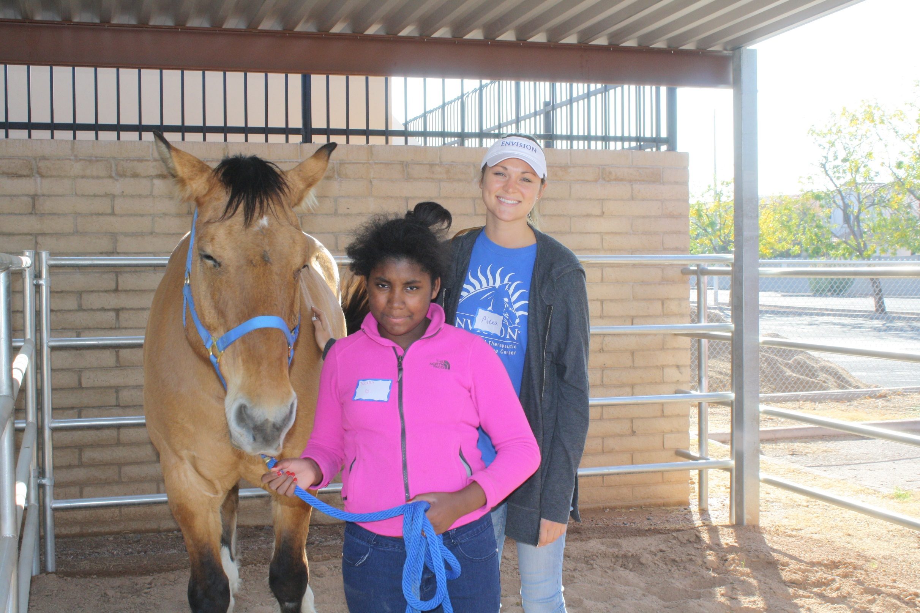
Welcome
www.envisiontherapy.org

Slide 20
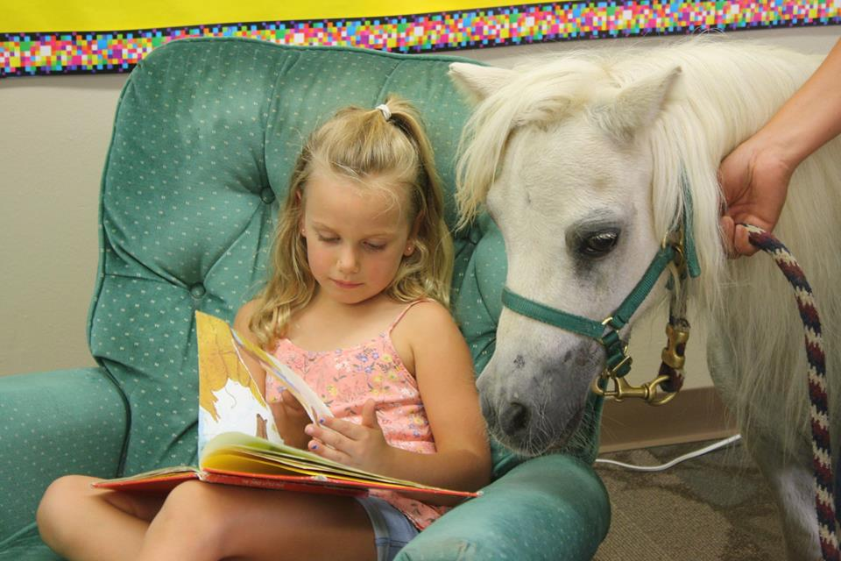
Welcome
www.envisiontherapy.org

Slide 21
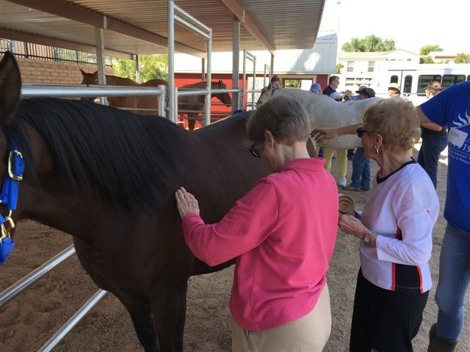
Welcome
www.envisiontherapy.org

Slide 22
Thank You
www.envisiontherapy.org

Slide 23
EAAT can help a variety of people in a variety of ways.
There is no “one size fits all”
Therapeutic riding for cognitive and physical disabilities
Equine assisted therapy– a licensed therapist
Equine assisted learning or “activities” includes education and coaching
Certifying organizations
PATH Professional Association of Therapeutic Horsemanship http://www.pathintl.org/
EAGALA Equine Assisted Growth and Learning Association http://www.eagala.org/
Others

Slide 24
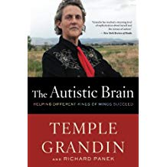
A few resources from Temple Grandin

Slide 25
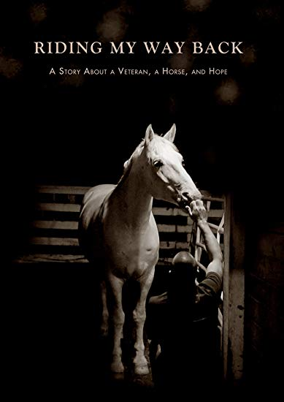
How horses have Helped Veterans, children with Autism and others

